Slide 1

Apply RoughTree to Dependency Parsing
Yangsheng Ji, Lin Shang, Xinyu Dai, and Ruoce Ma

Slide 2
Introduction
In natural language processing, dependency parsing is an important task as classification in data mining.
In data mining, classification is an important task.
...

Slide 3
Introduction
Naive-Bayes classification
Decision tree
a classifier with rough sets and Naive-Bayes hybrid in decision tree representation named RoughTree is proposed in this paper. This classifier is designed to alleviate the dependencies between attributes, and the attribute dependence measure in rough sets is applied to the classifier.

Slide 4
Related works
Dependency parsing
Naive-Bayesian classifiers
TAN & LBR & AODE

Slide 5
Rough Sets dependence measure (I)
In rough set theory, an information table is denoted by S=<U, A, V, f>, where U denotes a finite and nonempty set of instances, which is called universe; we have A=C∪D, and C∩D=∅, where A denotes the attribute set, and C is the nonempty condition attribute set and D is the nonempty decision attribute set, and often card(D)=1; V=∪_{a∈A} Va is the domain of attribute values; f is an information function such that f(ui,a)∈Va, for every a∈A and every ui∈U.

Slide 6

Rough Sets dependence measure (II)
lower and upper approximations
attribute dependence measure in rough sets is defined: Let P and Q be subsets of attributes in an information table, and P∩Q=∅, we have the degree of attribute set Q is dependent on attribute set P:

Slide 7
Theoretical foundations of RoughTree
This paper utilizes the variant of Bayesian theorem to analyze the attribute dependence and utilizes RoughTree algorithm to eliminate the attribute dependences.
The attribute dependences should be described as follows:
P(Ci|A1,A2)=P(Ci|A2)×P(A1|Ci,A2)/P(A1|A2)
∝ P(Ci|A2)×P(A1|Ci,A2)
∝P(Ci|A2)×ΠP(ai|Ci,A2)
ai∈A1, A1∪A2=A, and A1∩A2=∅.

Slide 8
Theoretical foundations of RoughTree
So the attributes in the set A1 are no longer independent only given the class label. They are mutually independent given both the class label Ci and the attributes set A2. Because of this, the attribute independence assumption gets weaker than the original attribute independence assumption.
This paper proposes RoughTree to find out the attributes set A2, and by utilizing the attribute independence assumption, Naive Bayesian classification can be carried out.

Slide 9
RoughTree algorithm (I)
Similar with Naive Bayesian classifiers and decision tree learners, RoughTree algorithm utilizes the rough set methodology to measure the attribute dependences, and splits the training data into subsets in order to alleviate the interdependences using a tree structure. The growth of RoughTree continues until there are no dependences in the subset of training data or the instances in the subset are less than a threshold. And finally, RoughTree generates a local Naive Bayesian classifier in each leaf node.

Slide 10
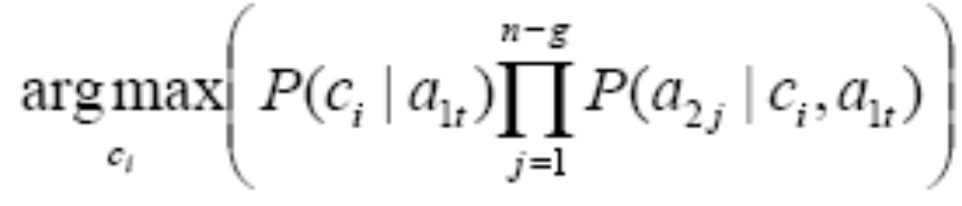
RoughTree algorithm (II)
Let A1={a11,…,a1g} denote the set of the test attributes on the path to the leaf, and let A2={a21,…, a2n-g} denote the set of the remaining attributes. RoughTree classifies the test example by choosing the class with the maximum posterior probability:

Slide 11
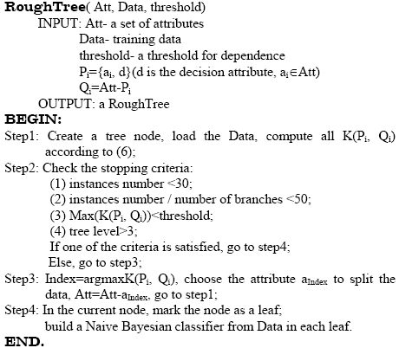
RoughTree Algorithm (III)

Slide 12
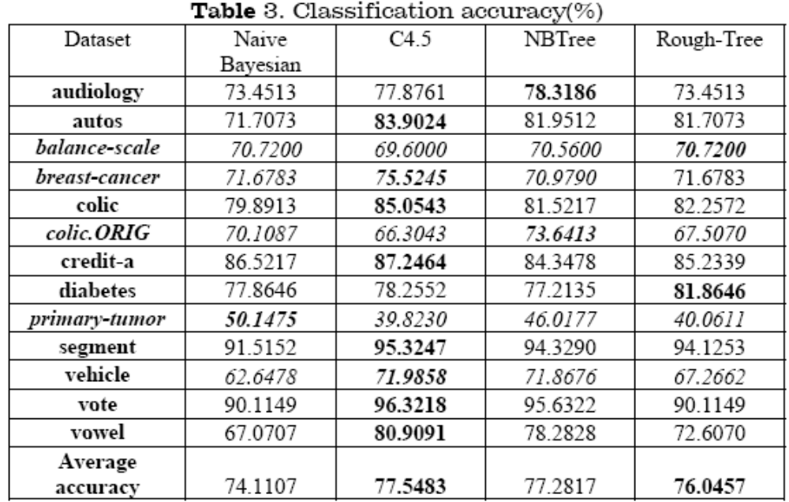
Experimental analysis

Slide 13
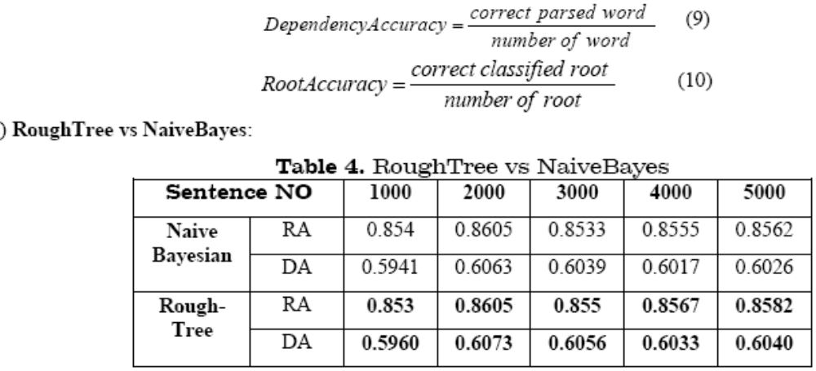
Experimental analysis

Slide 14
Conclusions and future work
1) The structure of RoughTree’s output model is similar with NBTree’s.
2) Novelty.
3) The key point of RoughTree algorithm is the attribute dependences measure.
1) Constructing RoughTree model is a time consuming process.
2) Improvement of the attribute dependence measure.
3) Modification on Nivre’s parsing algorithm to parsing Chinese sentences.

Slide 15
Thanks~

